Slide 1


Biomarkers in Treating Depression with Ayahuasca
Abhranil Das (Nil)
Dráulio Araújo lab

Slide 2
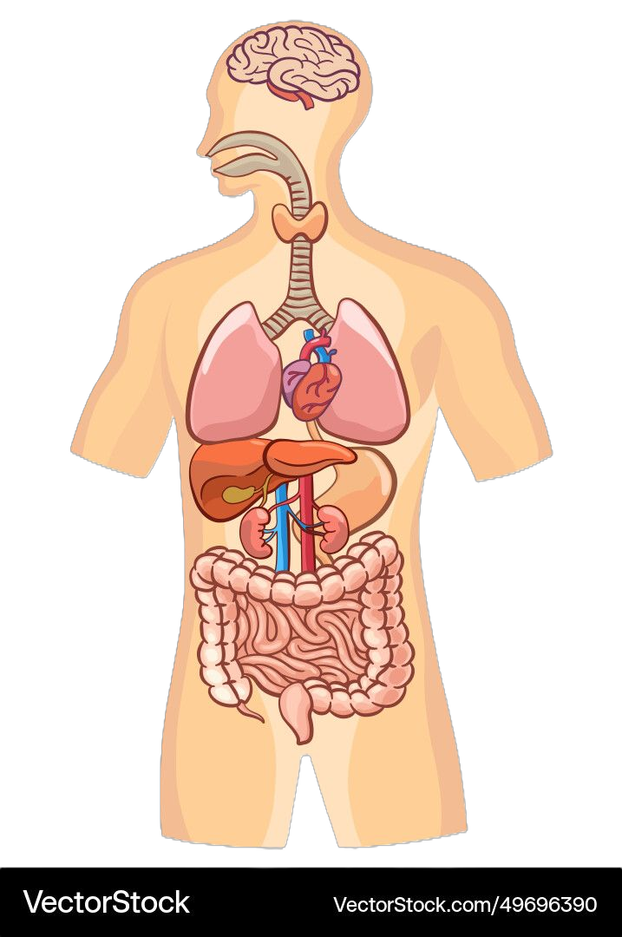
Questions
slide 2 of 11
Ayahuasca clinical trial for depression
brain:
BDNF
46 healthy, 29 with treatment-resistant depression
Each group split into ayahuasca and placebo
25 biomarkers collected before and after treatment
blood:
IL-6
RBC
WBC
platelets
neutrophil
monocyte
eosinophil
hematocrit
hemoglobin
lymphocyte
liver:
CRP
ALT
AST
LDL
HDL
glucose
triglycerides
How do biomarkers differ between healthy and depressed people?
How do biomarkers change after treatment in healthy and depressed people?
Which biomarker changes correlate with reductions in depression?
kidney/adrenal glands:
urea
cortisol
sodium
creatinine
potassium
Palhano-Fontes et al (2018). Rapid antidepressant effects of the psychedelic ayahuasca in treatment-resistant depression: a randomized placebo-controlled trial. Psychological Medicine

Slide 3
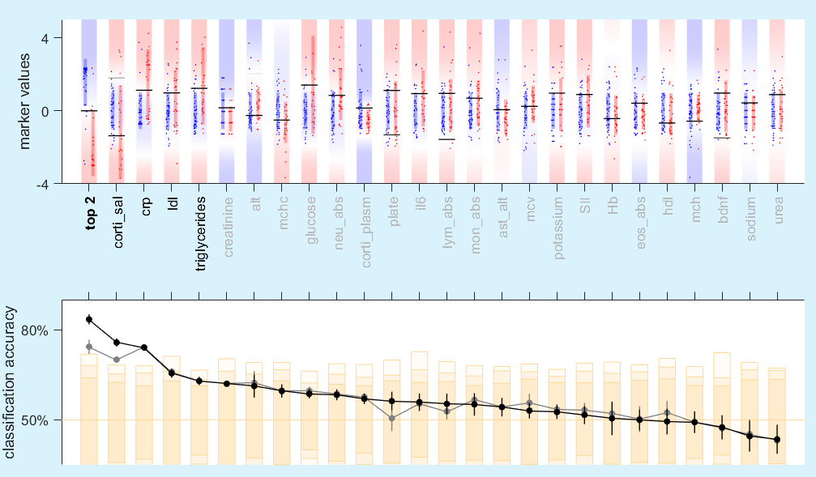
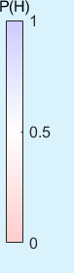
slide 3 of 11
1. How do biomarkers differ between healthy and depressed?
Depressed have both low and high salivary cortisol.
Low: fatigue / High: stress
Here we need 2 boundaries.
In depressed, CRP, triglycerides, glucose & IL-6 are higher.
1 boundary is good enough for most markers.
Only 4 markers have significant cross-validated separation.
Salivary cortisol and CRP are the best individual markers: 75% separation each.
CRP: inflammation, fatigue, anhedonia.
Top 2 markers combined is even better: 84% separation.
QDA boundaries
healthy depressed
***
***
***
*
quadratic:
2 boundaries
*
linear:
1 boundary
Notes:
Individual marker distributions. Rectangles are error bars.
The blue rectangles are all the same, because all markers have been z-scored wrt H0.
Agreement with marker lit.
Lines are classification boundaries using each individual marker. Explain QDA.
When two distributions vary in mean as well as sd, eg cortisol, the best classification boundary is a quadratic, not a linear. It has two boundaries, not one.
But one of those two boundaries may do most of the job (explain alpha).
The 5-fold CV test accuracy is plotted below, and the markers have been sorted by this.
In most cases, using the best single boundary is enough.
Corti_sal and crp are the best individual markers in distinguishing H from D.
The markers have been sorted by these, so the blue/red rectangles become more similar down the line.

Slide 4
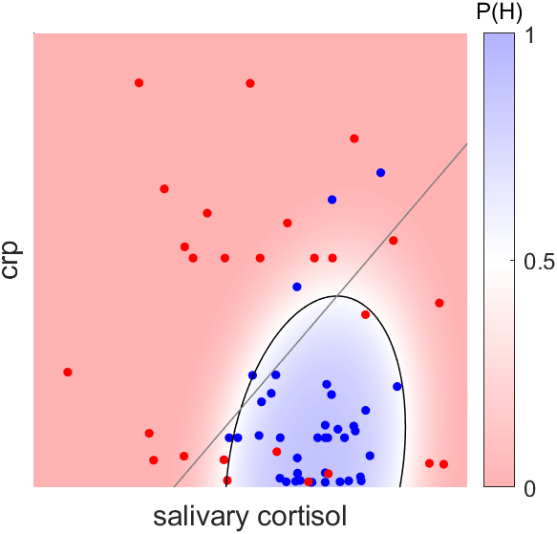
slide 4 of 11
Combining top 2 markers to separate healthy/depressed
healthy depressed
Colour-map is the Bayesian posterior probability of healthy.
Quadratic boundary exploits narrow range of cortisol in healthy, linear boundary can’t.
When combining a new marker, only new info counts.
Added CRP not because it is second-best, but because it adds the most separation.
P(H) is the single combined marker.
linear boundary: 74%
quadratic boundary: 84%

Slide 5
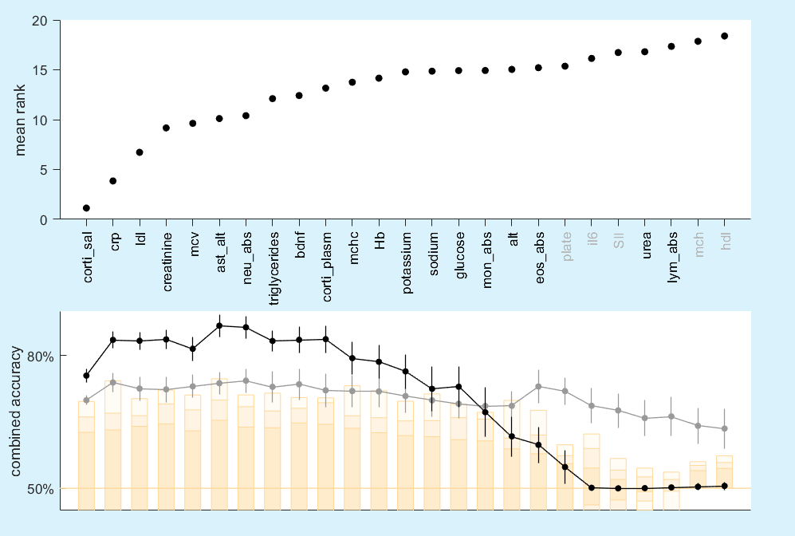
Building an optimal combination of separation markers
slide 5 of 11
Used greedy algorithm to add markers one by one.
Found mean ranks across many runs
Combined separation first rises (underfitting), then falls (overfitting).
Quadratic boundaries are significantly better than linear for up to 15 dimensions.
Combining salivary cortisol and CRP is good enough
Beyond these 2, best markers are not in order of individual separation accuracy
quadratic boundary
linear boundary

Slide 6
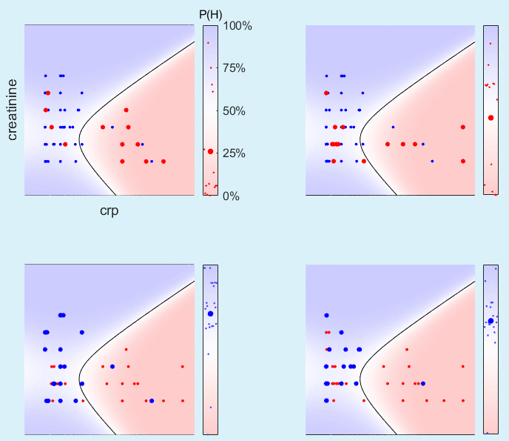
slide 6 of 11
2. How do markers change after treatment?
ayahuasca
placebo
healthy depressed
These markers are being restored towards healthy values after ayahuasca treatment.
Average P(H) rises from 25% to 50%.
No such change after placebo.
No overall change for the healthy, with ayahuasca or placebo.

Slide 7
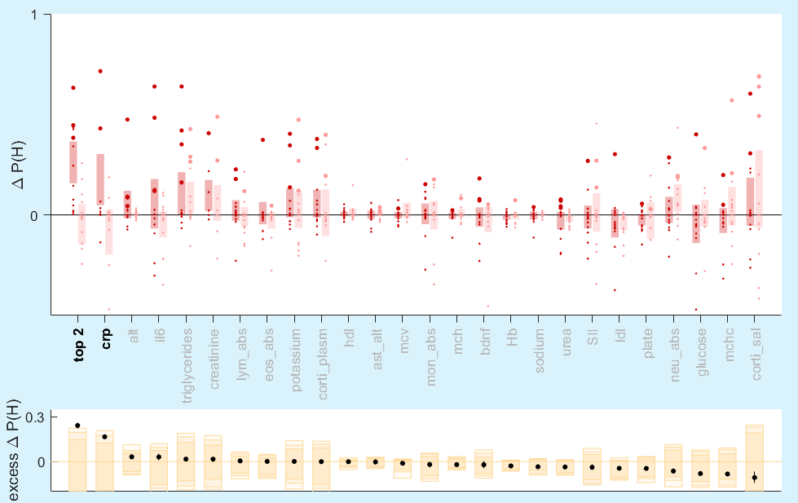
slide 7 of 11
2. How are markers of the depressed restored after treatment?
Markers are ranked by:
  how much aya treatment restores it towards baseline healthy
  how much more aya restores it compared to placebo
markers that most separate H/D are not the ones most restored.
only CRP shows significant restoration by itself
top 2 markers combined shows more significant restoration
ayahuasca placebo
***
*

Slide 8
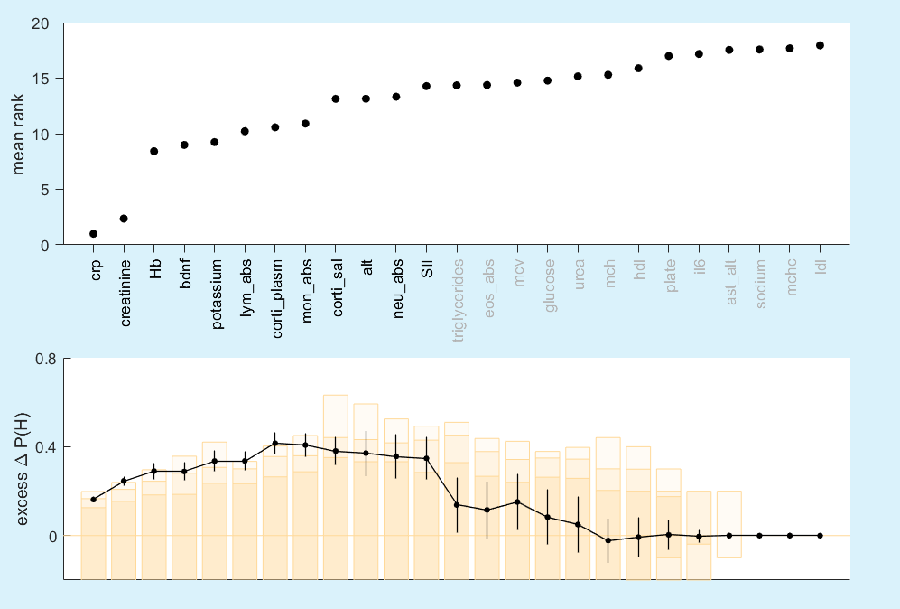
Building an optimal combination of restoration markers
slide 8 of 11
Combined restoration again first rises (underfitting), then falls (overfitting).
Combining CRP and creatinine is good enough

Slide 9
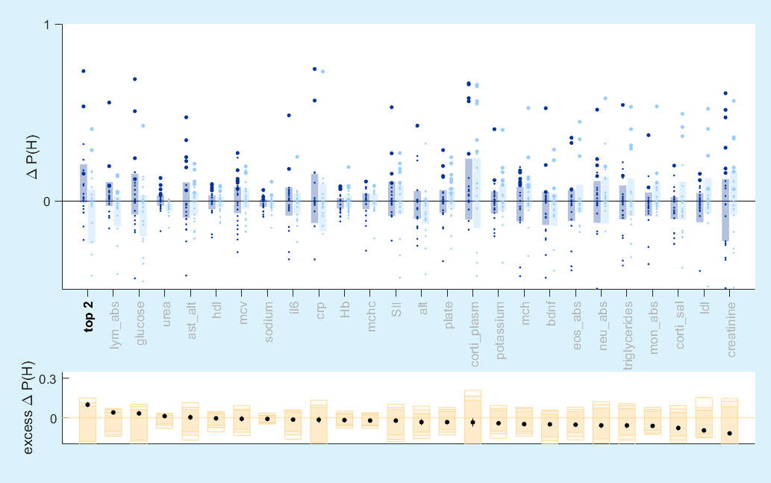
slide 9 of 11
3. Are markers of the healthy restored even more after treatment?
Psychedelics for the ‘betterment of well people’
ΔP(H) can show if the markers in the healthy shift even closer to healthy values.
No individual marker showed such significant restoration.
Combining the top 2: only marginally significant restoration.
ayahuasca placebo
*

Slide 10
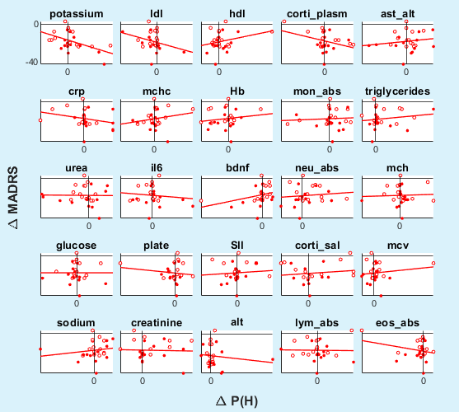
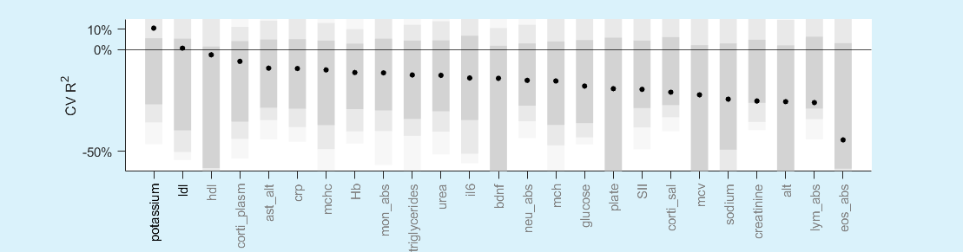
slide 10 of 11
4. Which marker restorations correlate with feeling better?
Plot against ΔP(H) of biomarker, instead of raw difference.
We keep placebo patients.
We want three criteria:
  negative slope
  cross-validated R² > 0
  p < 0.05
Only potassium and LDL shows a moderate effect.

Slide 11
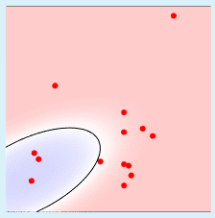
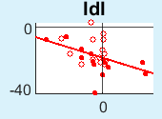
slide 11 of 11
Conclusions
Salivary cortisol and CRP together best separate baseline healthy from depressed, by 84%.
In the depressed, CRP & creatinine were restored most towards healthy values after ayahuasca treatment, compared to placebo.
In the healthy, no markers were restored much after treatment.
Restorations in Potassium and LDL are moderately correlated with improvements in depression.

Slide 12







Thanks
Fernanda Palhano-fontes
Rodrigo Santiago
Sergio Mota-Rolim
Inácio Gomes Medeiros
Wilson Geisler
UT Austin

